Slide 1

Web-based Inventory Control System for Southern Goods Distributors Pvt Ltd

Slide 2
Presented by:
2025-Y2-S1-MLB-B10G2-06
IT24102699 | Mummullage B.U.T
IT24102758 | Priyamalka W D N
IT24102784 | Panagodage N.M.H
IT24102773 | Siriwardane K.D.D.D
IT24102795 | Alahakoon A. M. J. P
IT24102798 | Sooriyabandara U.R.G.W.K
Year 01 – Semester 01
SE2030 – Software Engineering

Slide 3
Introduction
Project Overview:
This project is for Southern Goods Distributors, a company currently using manual, paper-based systems for inventory management. This leads to frequent stock errors, order delays, and poor visibility of stock levels.
Purpose & Objectives:
Purpose: To replace the inefficient manual processes with a centralized, effective, and easy-to-use web application.
Objectives: To provide real-time stock visibility, minimize errors through automation, streamline purchase orders, and improve overall business efficiency.

Slide 4
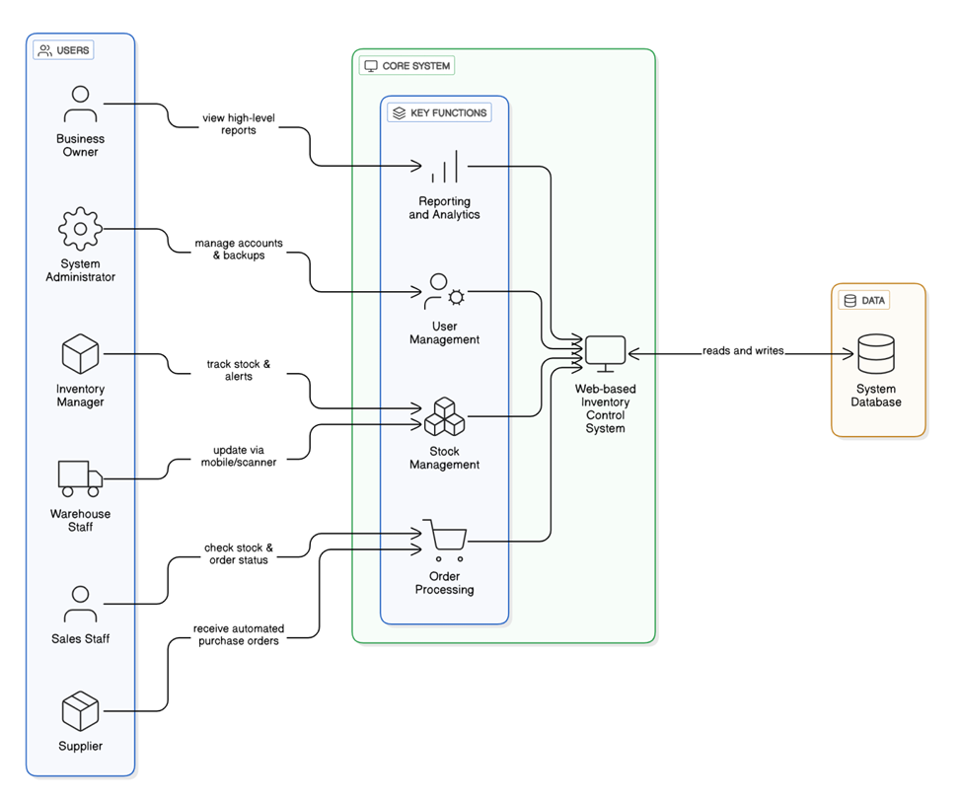
System Overview Diagram

Slide 6
Functional Requirements
Real-time Inventory Dashboard
Live view of stock levels,
low-stock alerts.
Purchase Order Management
Automated creation and tracking of
purchase orders.
Generate reports on
sales, stock value,
etc.
Business Reporting & Analytics
Warehouse Operations Interface
Generate reports on
sales, stock value,
etc.
User and Access Management
Secure, role-based
access for
all stakeholders.
Regular, reliable backups
to prevent data loss.
Automated Data Backups
01
02
03
04
05
06

Slide 7
Non-Functional Requirements
Performance
The system must provide
quick access to data.
Usability
It will have an intuitive
interface that is easy to use.
The system will feature reliable backups
and recovery procedures.
Security
Reliability
We will implement role-based
access and secure login protocols.
Scalability
The system must be able to support future company growth.
01
02
03
04
05

Slide 8
Major Stakeholders / Users
Business Owner
Makes strategic decisions using high-level reports.
Inventory Manager
Tracks stock levels and manages reordering processes.
Warehouse Staff
Handles physical stock, including picking, packing, and receiving goods.
Sales Team
Manages customer orders and checks real-time stock availability.
Suppliers
Receive automated purchase orders from the system.
System Administrator
Manages user accounts, security, and system backups.

Slide 9
Major Stakeholders / Users
Business Owner
Makes strategic decisions using high-level reports.
Inventory Manager
Tracks stock levels and manages reordering processes.
Warehouse Staff
Handles physical stock, including picking, packing, and receiving goods.
Sales Team
Manages customer orders and checks real-time stock availability.
Suppliers
Receive automated purchase orders from the system.
System Administrator
Manages user accounts, security, and system backups.

Slide 10
Major Stakeholders / Users
Business Owner
Makes strategic decisions using high-level reports.
Inventory Manager
Tracks stock levels and manages reordering processes.
Warehouse Staff
Handles physical stock, including picking, packing, and receiving goods.
Sales Team
Manages customer orders and checks real-time stock availability.
Suppliers
Receive automated purchase orders from the system.
System Administrator
Manages user accounts, security, and system backups.

Slide 11
Major Stakeholders / Users
Business Owner
Makes strategic decisions using high-level reports.
Inventory Manager
Tracks stock levels and manages reordering processes.
Warehouse Staff
Handles physical stock, including picking, packing, and receiving goods.
Sales Team
Manages customer orders and checks real-time stock availability.
Suppliers
Receive automated purchase orders from the system.
System Administrator
Manages user accounts, security, and system backups.

Slide 12
Major Stakeholders / Users
Business Owner
Makes strategic decisions using high-level reports.
Inventory Manager
Tracks stock levels and manages reordering processes.
Warehouse Staff
Handles physical stock, including picking, packing, and receiving goods.
Sales Team
Manages customer orders and checks real-time stock availability.
Suppliers
Receive automated purchase orders from the system.
System Administrator
Manages user accounts, security, and system backups.

Slide 13
Major Stakeholders / Users
Business Owner
Makes strategic decisions using high-level reports.
Inventory Manager
Tracks stock levels and manages reordering processes.
Warehouse Staff
Handles physical stock, including picking, packing, and receiving goods.
Sales Team
Manages customer orders and checks real-time stock availability.
Suppliers
Receive automated purchase orders from the system.
System Administrator
Manages user accounts, security, and system backups.

Slide 14
Major Functions
Used by
Sales Team
Purpose
Provides a real-time view of available stock, low-stock alerts, and incoming inventory. Helps sales staff confirm product availability instantly.
CRUD Operations
Create: New stock alerts are created when levels drop.
Read: Sales staff read stock levels and product details.
Update: The dashboard display is updated in real-time as stock is sold or received.
Delete: Alerts are deleted or cleared once addressed.
Inventory Dashboard

Slide 15
Purchase Order Automation
Used by
Inventory Manager
Purpose
Automates the creation and sending of purchase orders (POs) to suppliers via email or SMS. Tracks order status from creation to delivery.
CRUD Operations
Create: The manager creates new purchase orders.
Read: Views existing POs and their status.
Update: Updates the status of a PO (e.g., from 'sent' to 'confirmed' or 'delivered').
Delete: Cancels or deletes a purchase order before it is processed.

Slide 16
Business Reporting
Used by
Business Owner
Purpose
Provides high-level analytics and reports on stock movement, sales performance, inventory valuation, and identifies fast or slow-moving products.
CRUD Operations
Create: Generates new, custom reports based on selected parameters.
Read: The owner can view and analyze all generated reports.
Update: Reports can be refreshed to reflect the latest data.
Delete: Old or irrelevant reports can be deleted from the system.

Slide 17
Warehouse Interface
Used by
Warehouse Staff
Purpose
A mobile-friendly interface for managing physical inventory. Supports barcode scanners for searching, picking, packing, and updating stock levels in real-time.
CRUD Operations
Create: Adds new inventory records when goods are received.
Read: Scans a barcode to read product details and location.
Update: Updates stock quantities in real-time after picking an order or restocking shelves.
Delete: Removes a product record if it's discontinued or written off.

Slide 18
User Management
Used by
System Administrator
Purpose
Allows the administrator to manage all user accounts, assign roles (e.g., Sales, Warehouse), and set specific permissions to ensure data security.
CRUD Operations
Create: The admin creates new user accounts.
Read: Views a list of all users and their assigned roles/permissions.
Update: Modifies user details, changes roles, or resets passwords.
Delete: Deactivates or permanently deletes a user account.

Slide 19
Scalability & Training
Used by
All internal staff
Purpose
Ensures the system is easy to adopt and can grow with the company. Includes a user-friendly interface, help guides, and a flexible architecture.
CRUD Operations
Create: Admins can create new help articles or training modules.
Read: All users can read help guides and tutorials.
Update: Training materials can be updated as the system evolves.
Delete: Outdated help documents can be removed.

Slide 20
Minor Functions
Secure User Login and Logout system.
Password Reset and Recovery feature.
Search and Filter Options for large datasets.
Notifications and Alerts for low stock and order status.
Responsive Web Interface for desktops, tablets, and smartphones.
Data Export and Print Support in PDF or Excel formats.

Slide 21
System Limitations / Constraints
Internet Dependency
The system requires a constant internet connection to operate.
No Offline Mode
Users cannot interact with the system without an internet connection.
Initial Data Migration
Transferring data from old spreadsheets may be a challenge initially.
Training Requirement
Some staff, especially those used to manual systems, will require training.
Supplier Digital Readiness
The system's efficiency depends on suppliers being able to receive digital purchase orders.

Slide 22





PROJECT TIMELINE
Week
Week
Week
week
week
03
04 - 05
06 - 09
10 - 11
12 - 14
Finalize project concept and primary requirements.
Create system architecture, use cases, and UI mockups.
Develop backend, inventory control, warehouse interface, and reporting modules.
Perform integration testing, fix bugs, and gather user feedback.
Complete final documentation, prepare for presentation, and conduct final system demo and submission.

Slide 23
Conclusion
The proposed system offers a modern, integrated solution to revolutionize the inventory function at Southern Goods Distributors.
Value
Feasibility
Importance
With its scalable design and user-friendly interface, the system will not only solve current challenges but also support the company's future growth, providing a solid foundation for data-driven decisions.
By replacing manual procedures with a centralized platform, the system will reduce errors, improve accuracy, and enhance efficiency.

Slide 24

Thank You !

